Slide 1



EV Charging Demand Prediction
Name: Upendra Mohan Nandi
AICTE Student ID:STU6846a110ad89a1749459216
AICTE Internship ID: INTERNSHIP_175040797468551b2636342

Slide 2

Learning Objectives :-
1.Cleaned and organized messy EV adoption data into a structured format that’s easy to work with — helping us gain hands-on experience in working with real-world datasets.
2. Learned how to create meaningful features for the model, so it can understand trends over time — like time lags, growth rates, and moving averages.
3. Built and fine-tuned a Random Forest Regression model to accurately predict how electric vehicle adoption may change in the future.
4. Gained the ability to predict several months ahead using autoregressive methods, where each prediction depends on the one before it.
GOAL
Source :
www.freepik.com/

Slide 3
Tools and Technology used :-
Jupyter Notebook – Used for writing and experimenting with code in an organized and iterative manner during the development phase.
Python – Used as the core programming language for data preprocessing, feature engineering, model development, and forecasting.
Pandas & NumPy – Utilized for efficient data manipulation, cleaning, and handling time series-related operations.
Matplotlib & Seaborn – Used for visualizing trends, comparisons, and model predictions in a clear and interpretable way.
Scikit-learn – Employed for building and tuning the Random Forest Regression model using techniques like RandomizedSearchCV.
Stream lit – Used to deploy the machine learning model as an interactive web application for real-time EV demand prediction.

Slide 4
Methodology
1. Explored and understood the structure of the EV adoption dataset, identifying key columns, data types, and initial anomalies before cleaning.
2. Looked for patterns and missing values in the monthly EV adoption data.
3. Developed time-based features such as lag variables, month indicators, and moving averages to capture temporal patterns.
4. Used RandomizedSearchCV to fine-tune a Random Forest Regressor after it had been trained.
5. Forecasted future EV adoption month-by-month using an autoregressive approach.
6. Visualized predictions using Streamlit for better interpretation and presentation, making the model outputs interactive and accessible.
7. Worked in Jupyter Notebook for writing, testing, and visualizing code step-by-step during model development and experimentation.
8. Assessed the model’s performance and displayed the differences between the actual and expected outcomes.

Slide 5
Problem Statement:
The goal is to use the cleaned EV adoption dataset(which contains information about EV population, vehicle types, and past charging trends)to build a predictive model. This model should forecast how EV adoption may grow in the coming months or years. For example, predicting the number of electric vehicles that might be on the road in the near future based on current and historical trends.

Slide 6
Solution:
To solve the problem, we built a machine learning model using Random Forest Regression. This model was trained on historical EV data to learn important patterns and trends.
By selecting the right features, it could accurately forecast future EV adoption based on both numerical and categorical inputs.
The model is efficient, handles large datasets well, and is suitable for real-time applications due to its fast and accurate predictions.
GitHub Link :- https://github.com/upendra8454/Ev_Demand_Prediction_Project/tree/main/EV_Demand_Prediction

Slide 7

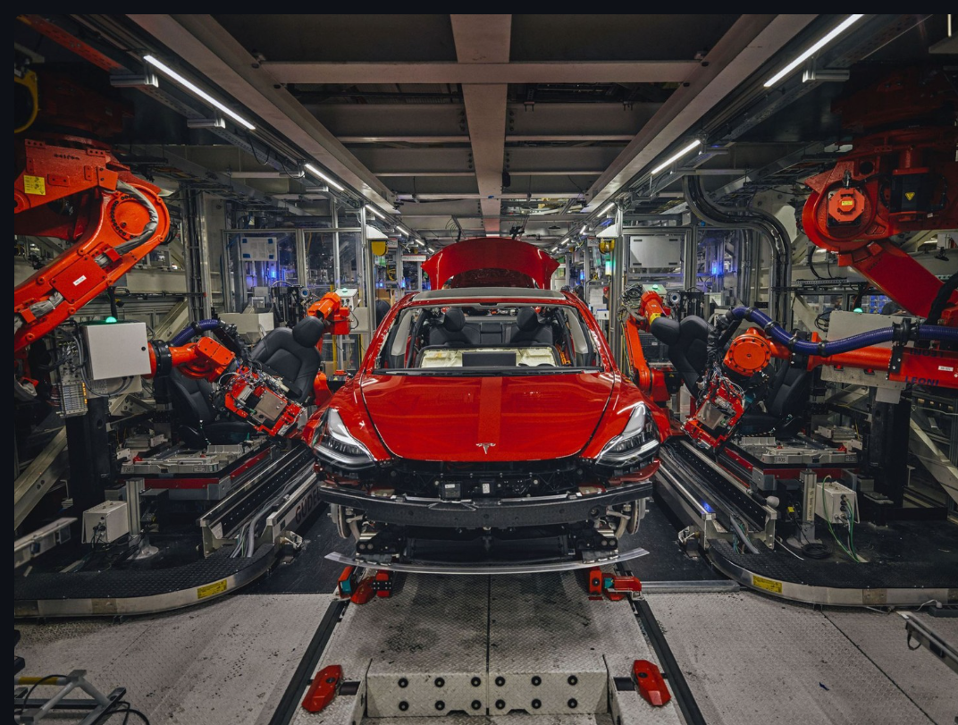
Screenshot of Output:

Slide 8

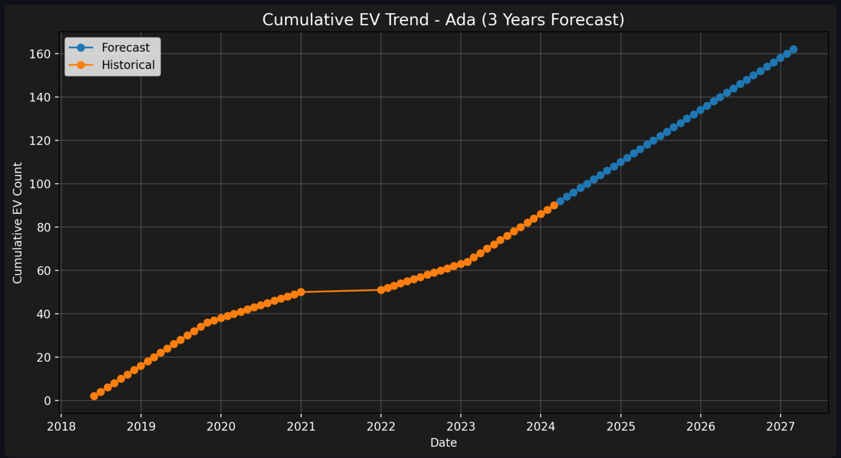
Screenshot of Output:

Slide 9
Screenshot of Output:

Slide 10
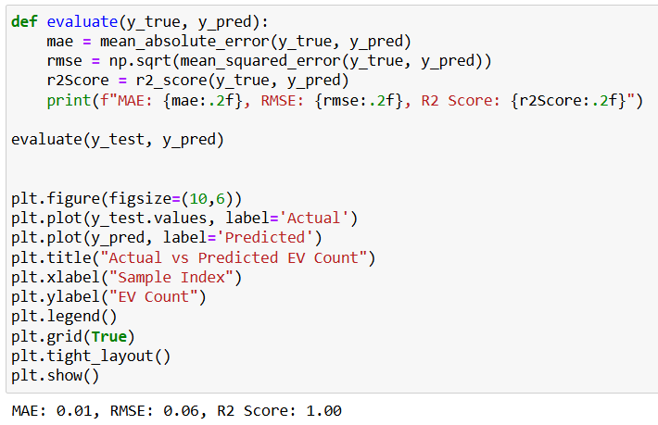
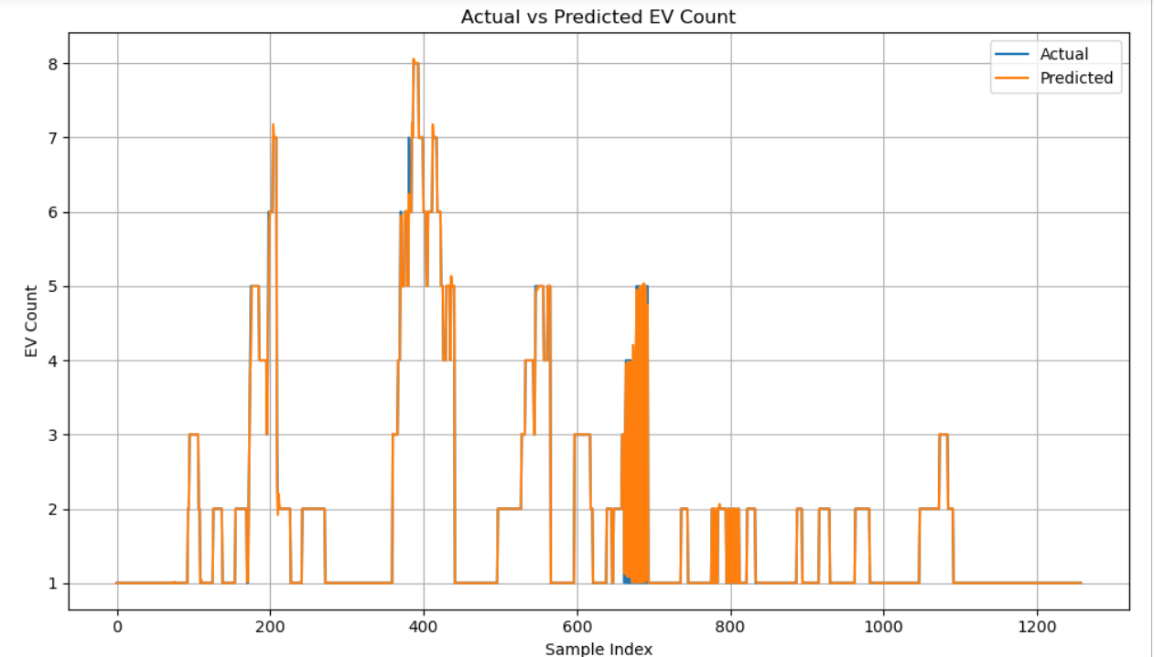
Screenshot of Output:

Slide 11
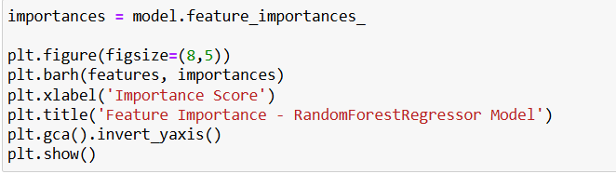
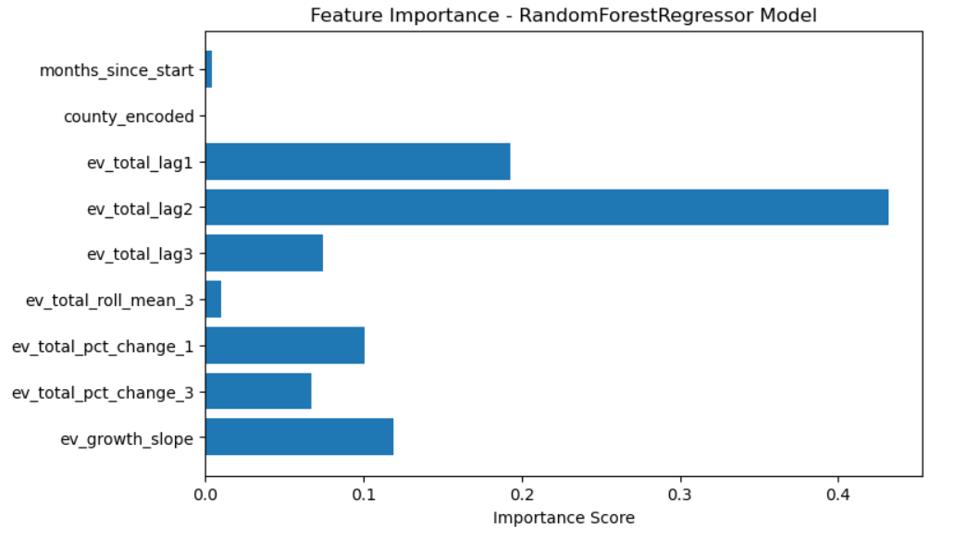
Screenshot of Output:

Slide 12
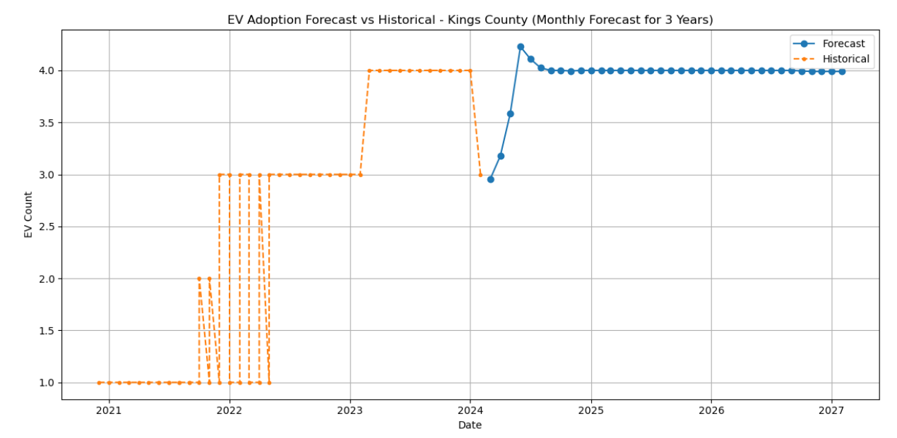
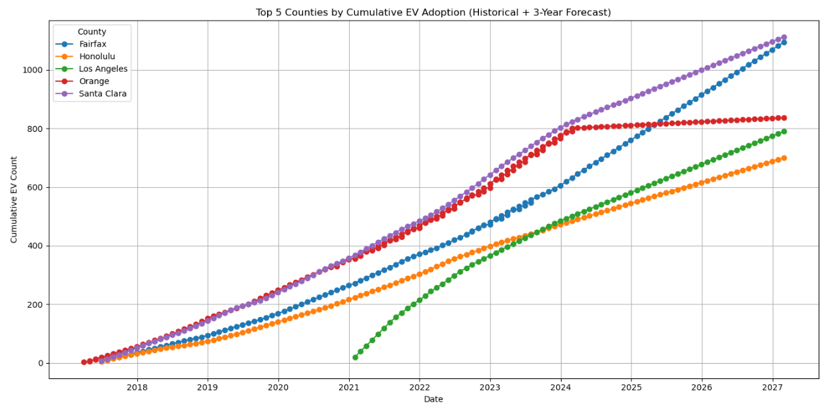
Screenshot of Output:

Slide 13
Conclusion:
The project successfully implemented a machine learning approach, specifically using the Random Forest model, to forecast Electric Vehicle (EV) adoption trends. The model demonstrated high accuracy and reliability in predicting future EV counts, validating the effectiveness of the selected features and techniques.These predictions provide actionable insights into EV growth, helping stakeholders, researchers, and policymakers understand how EV usage is expected to evolve in the coming years.
Future Scope : Incorporate External Variables: Enhance the model by including real-world factors such as fuel prices, government subsidies, and charging infrastructure expansion. Advanced Modeling: Explore more powerful models like XGBoost and LSTM (Long Short-Term Memory) for improved prediction accuracy, especially for time-series data. Scalability & Generalization: Apply the model to other regions or countries to test adaptability across different geographies and policies.

